Slide 1

ENERGY DEMAND FORECASTING SOFTWARE USING MACHINE LEARNING
DHANALAKSHMI SRINIVASAN ENGINEERING COLLEGE (AUTONOMOUS)
DEPARTMENT OF ARTIFICIAL INTELLIGENCE AND
DATA SCIENCE
PRESENTED BY
ALWIN ANTONY
(Reg. No. 8104212430008)
GLAISON ANTONY P J
(Reg. No. 810421243017)
SREEJITH S
(Reg. No. 810421243054)
Under the Guidance of,
Mr. M.PALANISAMY, (Supervisor)
Assistant Professor,
Department of Artificial Intelligence And Data Science,
Dhanalakshmi Srinivasan Engineering College,
Perambalur- 621212.

Slide 2
OUTLINE OF PRESENTATION
Domain Explanation
Abstract
Introduction
Objective
Literature Review
Existing work
Disadvantages
Proposed work
Advantages
System Architecture
List of Modules
Result
Conclusion
Future Enhancement
References

Slide 3
DOMAIN EXPLANATION
Machine learning is a branch of artificial intelligence that enables computers to learn from data.
Make decisions predictions without being explicitly programmed..
The learning process often involves training models, testing them, and refining them to improve accuracy.
Supervised Learning
The algorithm is trained on labeled data
Unsupervised Learning
The algorithm is given data without any labels and must find hidden structures in the data on its own.

Slide 4
ABSTRACT
Efficient Energy Management – Helps balance energy supply and demand in markets, industries, and homes.
Machine Learning Forecasting – Uses AI to predict energy needs for different times and situations.
Real-Time Monitoring – Tracks environmental factors like temperature, humidity, and wind speed.
LCD Display – Shows real-time environmental data for easy monitoring.
AI-Based Analysis – Analyzes inputs to predict energy demand patterns in various sectors.
Optimized Resource Allocation – Identifies peak demand periods for better energy distribution.

Slide 5
INTRODUCTION
Energy demand forecasting ensures efficient generation, distribution, and utilization of energy.
Accurate forecasting reduces operational costs, prevents power shortages, and optimizes grid stability.
Traditional forecasting methods struggle with dynamic and complex energy consumption patterns.
Machine learning (ML) provides a more accurate and adaptive approach by analyzing historical data.
This study develops a software solution leveraging ML algorithms to improve energy demand forecasting.
The software integrates real-time data processing, predictive modeling, and smart grid compatibility

Slide 6
OBJECTIVE
Create an AI system to predict energy demand using environmental data.
Track temperature, humidity, and wind speed in real time.
Predict energy needs during peak hours, shifts, and seasons.
Include seasonal changes like summer cooling and winter heating.
Use analytics to forecast demand during extreme weather or industry activity.
Suggest ways to use energy efficiently and save costs.
Help reduce energy use and cut carbon emissions.
Give energy managers accurate data for better decisions.

Slide 7
LITERATURE REVIEW
Title of the Paper | Journal Name | Author, Year | Content
Machine Learning for Demand Forecasting in Manufacturing. | Research Gate | Sai Mani Krishna Sistla, Gowrisankar Krishnamoorthy (2024) | This paper explores how machine learning is used for demand forecasting in manufacturing, reviewing methods, challenges, evaluation metrics, and offering recommendations for better accuracy, data quality, and future research.
Short-term water demand forecasting using data centric machine learning approaches | Research Gate | Guoxuan Liu, Dragan Savic Da,b,c and Guangtao Fua. (2023) | This study uses a data-centric machine learning approach to improve short-term water demand forecasting, showing that models like Random Forest and Neural Networks perform well with limited data, high-resolution inputs, and that improving data quality can enhance accuracy as much as focusing on model choice.

Slide 8
LITERATURE REVIEW
Title of the Paper | Journal Name | Author, Year | Content
Machine Learning Forecasting of Daily Delivery Positions: A Modern Take on Industrial Workforce Planning | Research Gate | Lukas Hans, Patrick Eichenseer. (2023) | The logistics industry faces challenges in warehouse workforce planning due to a shortage of skilled workers and unpredictable customer demand, leading to inefficiencies, higher costs, and difficulties in meeting service expectations
Energy Demand Forecasting for Türkiye: Comparison Between Traditional Machine Learning Algorithms and Ensemble Learning Algorithms | Research Gate | Ahmet Tezcan Tekit, Cem Sarl. (2023) | This study highlights the importance of energy demand forecasting for effective planning and resource management, using Türkiye's 2016–2023 energy data to compare traditional and ensemble machine learning methods for future demand prediction.

Slide 9
EXISTING WORK
Existing energy demand forecasting systems have adaptability and accuracy limitations.
Traditional EMS uses statistical models like regression and time-series forecasting for predictions.
Limited in handling sudden fluctuations due to weather changes, economic activities, or unexpected demand spikes.
Simulation-Based Forecasting
Relies on mathematical models to simulate energy demand under different scenarios.
Requires extensive data inputs and is computationally intensive.
AI and Machine Learning-Based Models (Limited Adoption)
Time-Series Forecasting Models.
Utilize past consumption data to make future predictions.

Slide 10
DISADVATAGES
Limited Adaptability and Accuracy: Traditional systems struggle to adapt to dynamic and rapidly changing conditions.
Inability to Handle Real-Time Environmental Factors: Weather changes and other environmental conditions are not well integrated into forecasts.
Dependence on Statistical Models: Regression and time-series models work well only under stable conditions and fail during sudden changes.
Smart Grids Focus on Monitoring, Not Forecasting: Equipped with sensors but mainly used for distribution and real-time monitoring, not advanced prediction.
Lack of Use of External Variables: Systems often ignore crucial inputs like temperature, humidity, and other contextual data.

Slide 11
PROPOSED WORK
System enhances energy demand forecasting by integrating machine learning with real-time environmental data for accurate predictions.
It uses sensors to monitor environmental parameters like temperature, humidity, and wind speed, which impact energy demand.
The machine learning model analyzes real-time data to recognize patterns in energy consumption, adapting to weather changes and seasonal variations.
Provides an interactive dashboard for users to input data, visualize trends, and access reports.
Allows customization of forecasting parameters based on user preferences.
Supports demand-side management and load balancing to reduce energy wastage.

Slide 12
ADVANTAGES
Real-Time Data Integration: Combines machine learning with real-time environmental data (e.g., temperature, humidity, wind speed) for dynamic predictions.
Improved Forecast Accuracy: Machine learning models trained on both historical and environmental data help improve prediction precision.
Adaptive to Seasonal and Weather Changes: Automatically adjusts to seasonal demands (e.g., cooling in summer, heating in winter).
Sector-Wise Prediction: Accurately predicts energy demand for different sectors: residential, commercial, and industrial.
Optimized Resource Allocation: Helps energy managers allocate resources effectively during peak demand or extreme weather conditions.

Slide 13
SYSTEM ARCHITECTURE
POWER SUPPLY FOR ALL
UNIT
MICRO
CONTROLLER
HUMIDITY
USB TO UART
PC
TEMPERATURE
IOT
WIND SPEED
LCD

Slide 14
HARDWARE AND SOFTWARE REQUIREMENTS
HARDWARE REQUIREMENT
TEMPERATURE SENSOR
IOT ESP8266
LCD DISPLAY
HUMINITY SENSOR
WIND SENSOR
MICRO CONTROLLER
SOFTWARE REQUIREMENT
ARDUINO IDE
EMBEDDED C

Slide 15
LIST OF MODULES
Data Ingestion Module
Data Preprocessing & Cleaning Module
Feature Engineering Module
Forecasting Engine (ML Model Module)
Explainability & Interpretation Module

Slide 16
LIST OF MODULES
Data Ingestion Module
Purpose: To collect and import raw data from various sources.
Description: This module is responsible for collecting and fetching data from various sources such as databases, APIs, sensors, and files. It ensures that the incoming data is properly formatted, cleaned, and structured before being transferred for further processing. The module plays an essential role in maintaining data quality and consistency throughout the pipeline.

Slide 17
LIST OF MODULES
Data Preprocessing & Cleaning Module
Purpose: To prepare raw data for analysis.
Description: This module involves preparing the raw data by handling missing values, removing duplicates, and standardizing formats to ensure consistency. It also focuses on correcting any data inconsistencies and making sure that the data is clean, accurate, and properly structured so that it is ready for effective analysis and modeling.

Slide 18
LIST OF MODULES
Feature Engineering Module
Purpose: To enhance model performance by creating informative input features.
Description: The Feature Engineering Module is designed to improve model performance by transforming raw data into meaningful input features. It does this by using various techniques such as encoding, scaling, binning, or creating new variables from existing ones, helping the model better understand and learn from the data.

Slide 19
LIST OF MODULES
Forecasting Engine (ML Model Module)
Purpose: To predict future values using machine learning models.
Description: The Forecasting Engine (ML Model Module) is designed to predict future values using machine learning models. It works by applying statistical or machine learning algorithms to generate forecasts. This process may involve several steps, including model training, validation, and setting up prediction pipelines to ensure accurate and reliable results.

Slide 20
LIST OF MODULES
Explainability & Interpretation Module
Purpose: To make model predictions understandable to users.
Description: The Explainability & Interpretation Module is designed to make model predictions understandable to users. It utilizes tools such as SHAP or LIME to explain how different input features impact the model’s decisions. By providing insights into the reasoning behind predictions, this module helps enhance trust and transparency in the model’s behavior.

Slide 21
RESULT
The ML-based system accurately predicted energy use in residential, industrial, and commercial sectors.
It used real-time data like temperature, humidity, and wind speed to adapt forecasts to changing conditions.
The system performed well during peak times, like hot summers and cold winters.
It improved prediction accuracy by learning from past usage and environmental patterns.
Energy managers could better plan distribution to avoid overloads and outages.
The system helped find energy-saving opportunities during off-peak hours for efficient management.

Slide 22
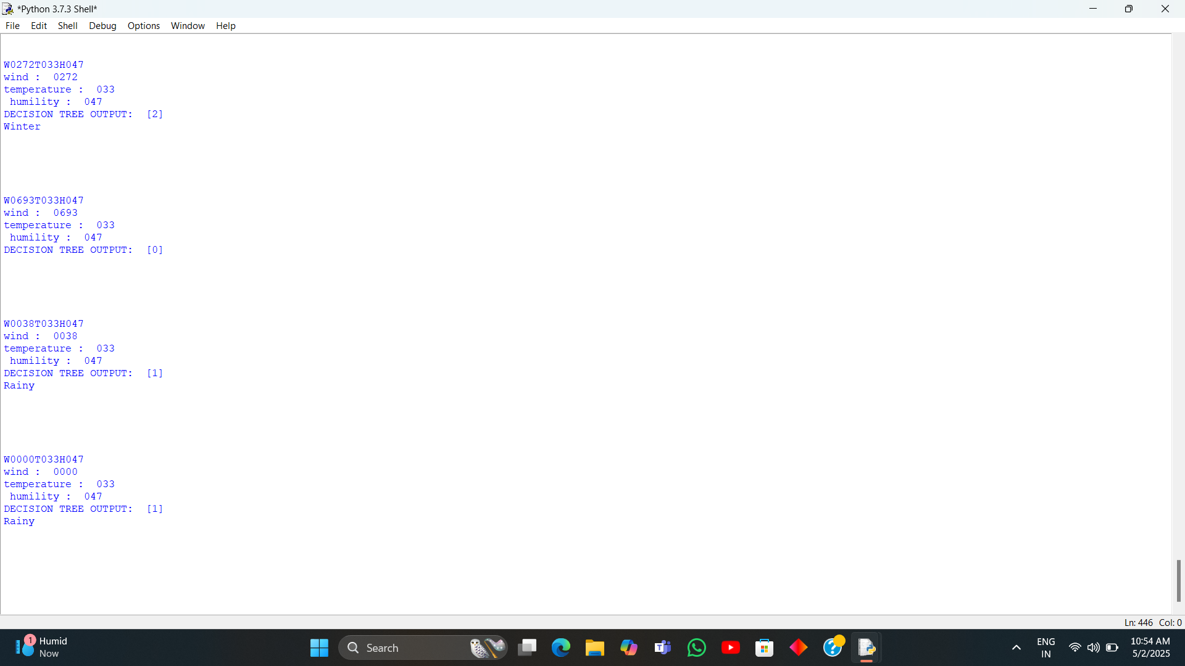
RESULT

Slide 23
CONCLUSION
Combines machine learning, real-time environmental data, and IoT for accurate energy demand forecasts.
Offers better accuracy and real-time insights compared to traditional methods.
Supports cost-effective and efficient energy management.
Enables precise forecasting for smarter resource allocation and less energy waste.
Contributes to sustainability by promoting efficient energy use.
Empowers energy managers with data-driven tools for informed decision-making.
Helps build a more reliable and sustainable energy future.

Slide 24
FUTURE ENHANCEMENT
Forecasting & Alerts: Early warnings for heatwaves, storms, etc.
Environmental Monitoring: Tracking changes in climate.
Agriculture: Helps farmers with irrigation and crop planning.
Energy: Useful for wind energy assessments.
Public Comfort & Health: Helps in planning outdoor activities and managing public health risks (e.g., heat exhaustion)

Slide 25
REFERENCES
Machine Learning for Demand Forecasting in Manufacturing Sai Mani Krishna Sistla1, Gowrisankar Krishnamoorthy. Jawaharbabu Jeyaraman3, Bhargav Kumar Konidena41Soothsayer Analytics, USA2HCL America, USA3TransUnion, USA 4 State Farm, USA
Energy Demand Forecasting for Türkiye: Comparison Between Traditional Machine Learning Algorithms and Ensemble Learning Algorithms Ahmet Tezcan Tekih, Cem Sar Department of Management Engineering. Istanbul Technical University, Türkiye Department of Industrial Engineering. Istanbul Technical University. Türkiyetekina@itu.edu.tr. saric21@itu.edu.tr.
An Intelligent Hybrid Machine Learning Model for Sustainable Forecasting of Home Energy Demand and Electricity PriceBanafshe Parizad, HdssanRanjbarzadeh, Alijamali1.30 and Hamid Khayyam 1,School of Engineering, RMIT University, Melbourne 3000, Australia: 54023374@student.mit.edu.au (B.P alijamali@knu.ac.kr (A1)2 School of Engineering, Deakin University, Geelong 3217, Australia; hranjbar@deakin.edu.au Department of Artificial Intelligence, School of Electronics Engineering, Kyungpook National University, Daegu 372 37224, Republic of Korna Correspondenor hamid.khayyam@rmit.edu.au.

Slide 26
REFERENCES
Machine Learning-Driven Demand Forecasting: A Comparative Analysis of Advanced Techniques and Real-Time Integration Satish Anchuri Walmart, US
Short-term water demand forecasting using data centric machine learning approachesGuoxuan Liu, Dragan Savic Da,b,c and Guangtao Fua,"Exeter, Enter Ex140F, U"Corresponding author. E-mail gheracik01. 0000-0001-4833-8352:06. 0000-0003-456-7-9041
Machine Learning Forecasting of Daily Delivery Positions: A Modern Take on Industrial Workforce Planning Lukas Hans1, Patrick Eichenseer2, and Matthias Groß1Institute for Data Science, Engineering, and Analytics, TH Köln Steinmüllerallee 1, 51643 Gummers batch, Germany E-Mails: lukas.hans@th-koeln.de, matthias.gross2@th-koeln.de2Head of Operational Excellence, DEHN SE Umelsdorfer Str. 8, 92280 Utzenhofen, GermanyE-Mail: patrick.eichenseer@dehn.de

Slide 27
Thank You

